Slide 1
Machine learning applied to the optimal operation of the uruguayan energy system
Ruben Chaer - March 6, 2023
Gerente de Técnica y Despacho Nacional de Cargas
Montevideo - Uruguay
One of the main tasks of ADME is the operation of the national electrical system to guarantee the supply of energy at a minimum cost.
The purpose of this presentation is to tell you how we are using Machine Learning for this task and to comment on some particular aspects of this field of application.
Notes:
Good afternoon everyone and thank you for being here. One of the main tasks of ADME is the operation of the national electrical system to guarantee the supply of energy at a minimum cost.
The purpose of this presentation is to tell you how we are using Machine Learning for this task and to comment on some particular aspects of this field of application.

Slide 2

Uruguayan Energy Market
Uruguay's generation matrix is 90% renewable. Approximately 10% based on biomass, 30% on wind and solar and 50% hydropower.
Wind an Solar are variable in terms of hours but firm in terms of weeks.
Hydropower is stable in terms of hours but has strong annual variability.
These random components result in a cost of the future operation with huge dispersion.
White paper:
Operación óptima de los recursos de generación de energía eléctrica
(spanish)
https://adme.com.uy
Notes:
Uruguay's generation matrix is 90% renewable. Approximately 10% based on biomass, 30% on wind and solar and 50% hydropower.
Wind an Solar are variable in terms of hours but firm in terms of weeks.
Hydropower is stable in terms of hours but has strong annual variability.
These random components result in a cost of the future operation with huge dispersion.

Slide 3
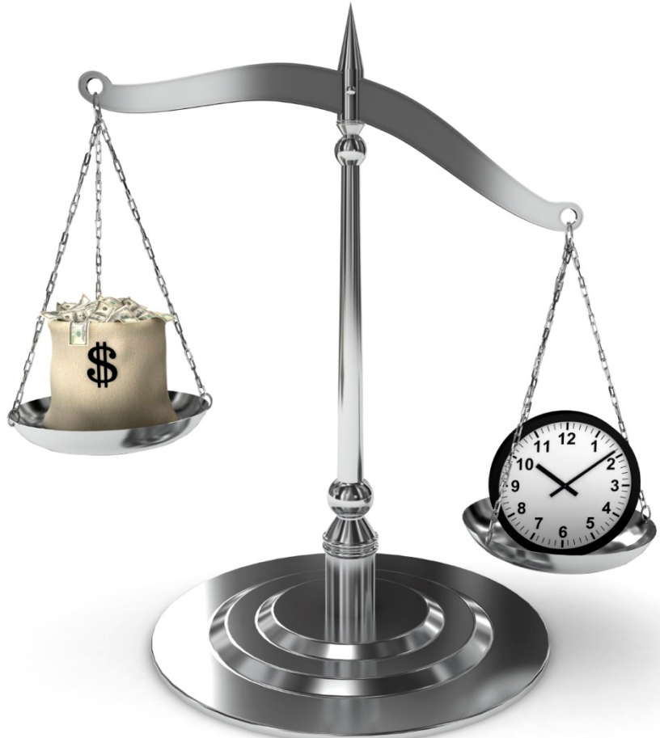
The optimal dispatch of generation resources is a Stochastic Dynamic Programming problem.
The use of stored resources (water) today reduces the operating costs of the present but increases those of the future, and vice versa.
An optimal policy is one that reduces the expected value of the future operating cost of the system.
Min <Future Cost>
At the optimum, the variations of Present vs. Future are in equilibrium.
Notes:
The optimal dispatch of generation resources is a Stochastic Dynamic Programming problem.

Slide 4
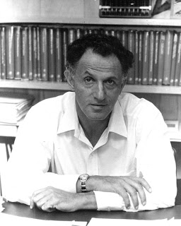
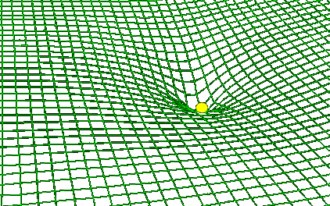
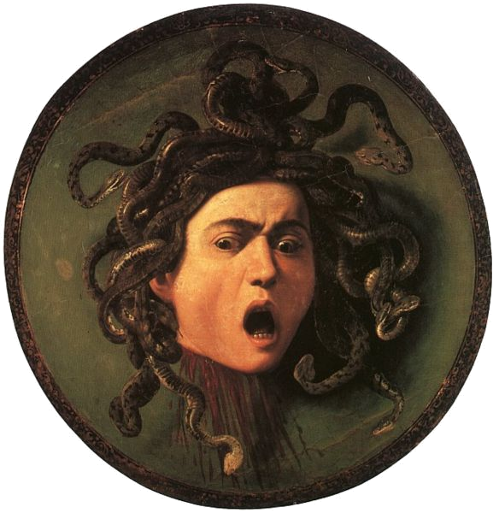

Dynamic Programming 1957
Bellman recursion
Bellman's Curse of Dimensionality
Richard Ernest Bellman (1920–1984)
Notes:
In 1957 Richard Bellman published a solution to Stochastic Dynamic Programming problems.
In the same publication, Bellman stated that his algorithm suffered from what he called The Curse of Dimensionality.
The computational effort of his algorithm exploded in a combinatorial way when the number of state variables and random variables considered increased.

Slide 5




Robots VATES: Energy dispatch with integration of the SIN status and forecasts on a continuous basis.
At ADME we have two Robots that are permanently solving the optimal dispatch.
Both assimilate the information on the state of the system and on the forecasts of rainfall, wind, solar radiation and Demand and resolve the optimal operation policy.
One Robot analyzes the next three months with daily detail and publishes the results twice a day.
The other analyzes the next seven days with hourly detail and publishes the results every hour.
Both robots use the Bellman Recursion, which condemns us to not be able to continue adding state variables and details to the system model.
This led us to develop a new generation of Robots based on Artificial Intelligence techniques to try to escape the Bellman Curse.
VATES_MP (every 12 hrs)
(next 3 months with daily step)
VATES_CP
(every hour)
(next 168 h)
Notes:
At ADME we have two Robots that are permanently solving the optimal dispatch.
Both assimilate the information on the state of the system and on the forecasts of rainfall, wind, solar radiation and Demand and resolve the optimal operation policy.
One Robot analyzes the next three months with daily detail and publishes the results twice a day.
The other analyzes the next seven days with hourly detail and publishes the results every hour.
Both robots use the Bellman Recursion, which condemns us to not be able to continue adding state variables and details to the system model.
This led us to develop a new generation of Robots based on Artificial Intelligence techniques to try to escape the Bellman Curse.

Slide 6

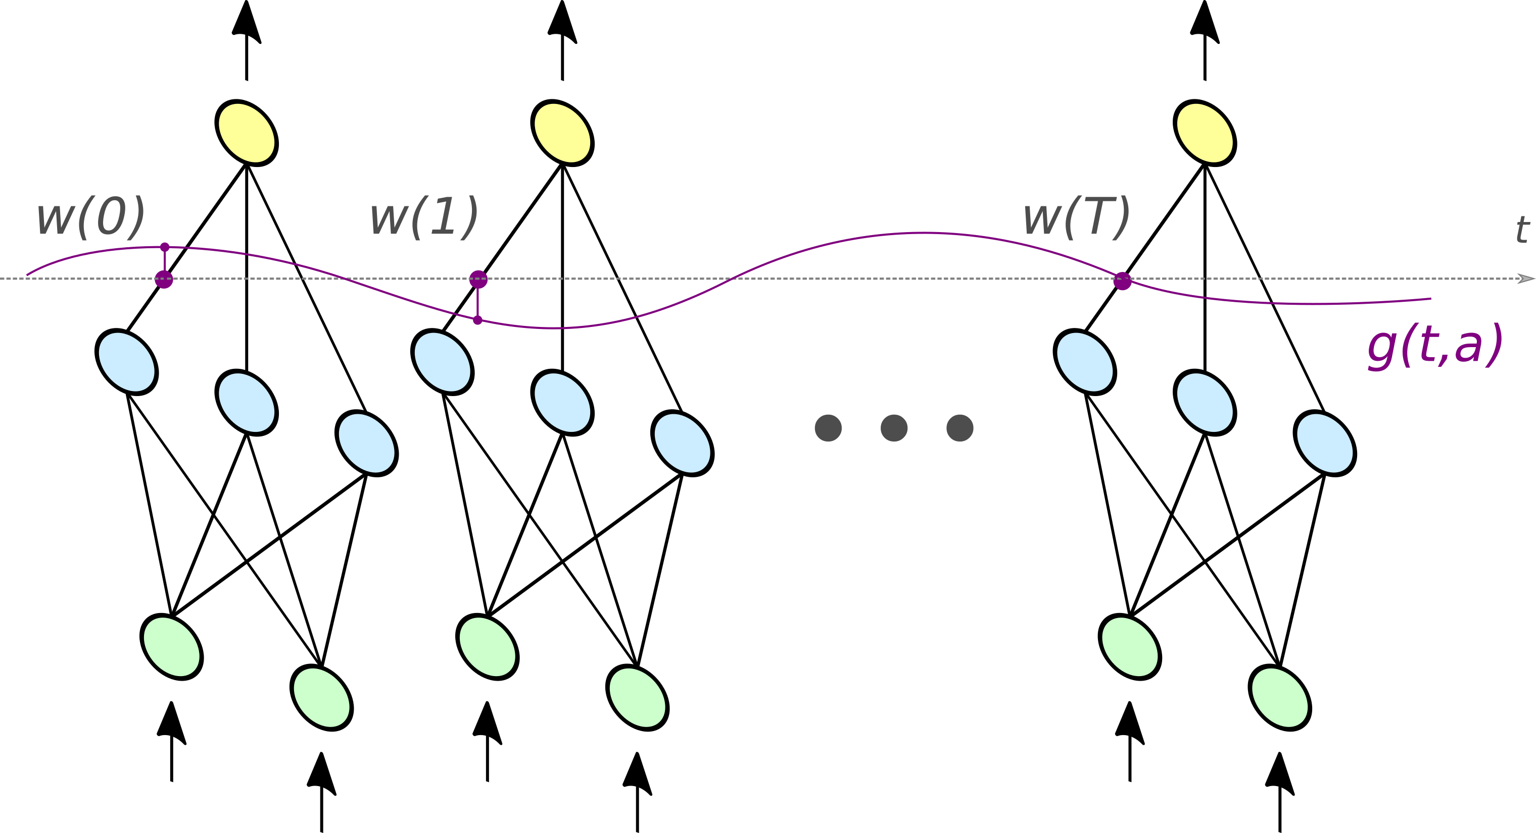
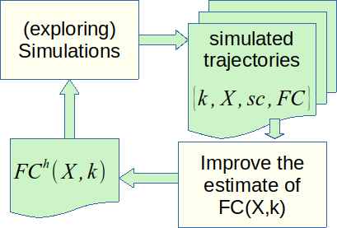
2nd generation of robots with artificial intelligence
VatesIA_MP y VatesIA_CP
Notes:
The structure of both robots is the same. Both have an array of neural networks, one per time step. These networks attempt to model the future cost function.
The robots are in a permanent learning loop, simulating multiple possible trajectories of the operation using their representation of the future cost function and improving it based on the information on the operational costs collected during the simulations.

Slide 7


FC(X) representation and regularizations
Parsimony(t)
TD
Power series and harmonics
p=2 : Ridge
p=1 : Lasso
Approximate the differences instead of the function itself
Notes:
The first key for success is to train the ensemble of neural networks to capture the spatial differences of the future cost function.
In addition, standard regularizations such as Ridge or Lasso are applied, and the variation of the parameters over time is also regularized, imposing a cost on the variation of the parameters between adjacent networks.

Slide 8
The information is in the FC(X) differences
Use Common Random Numbers to prevent the FC(X) variance from confounding the calculation of the differences: FC(Xa) - FC(Xb) at the arrival states
Notes:
All the time the Robots are computing the vector control that minimizes the sum of the step cost plus the Future Cost at the arriving state.
Note that in solving this problem the constant term of the future cost function is not relevant.
The information is in the spatial derivatives of the Future Cost.
The second key to success is to reduce the information variance. To do that, we use Common Random Numbers , a well known technique for reducing the variance of the difference of two random variables in Montecarlo simulations.

Slide 9
Exploration Strategies
In a stable system, the use of CRN leads to convergence of trajectories and a consequent loss of exploration capability. Each NTD steps states are exploited to recover said capability.
Notes:
Using Common Random Numbers imply that the system random inputs are the same for all the simulated trajectories at each simulation stage.
As consequence of this, it is necessary to start the simulated trajectories at different states in order to create different trajectories for exploring the state space.
During the simulations, the trajectories converge as the system is subjected to the same random inputs, thus losing exploration ability. To recover the exploration capacity, it is necessary to break with the natural evolution imposed by the dynamics of the system and exploit the states of the trajectories randomly from time to time.

Slide 10

In a continuously operated system, learning is also processed continuously. With the course of each real hour, the vector of neurons is moved, discarding the one corresponding to the elapsed hour and repeating the last neuron of the set to continue in the learning loop
Notes:
In a continuously operated system, learning is processed continuously and the Robots take advantage of the previously acquired knowledge.

Slide 11

That's all folks!
Thank you for your attention.

